Slide 1



Space Partitioning Trees
Interval Trees, Quad Trees, K-d Trees
Tree-Like Structures
SoftUni Team
Technical Trainers
Software University
http://softuni.bg

Slide 2

Table of Contents
Interval Trees
Interval Intersection Search
Rectangle Intersection Search – Sweep Line Algorithm
Quad Trees
Object Intersection Search
K-d Trees
Point Range Search

Slide 3
Interval Trees
(20..36)
(3..41)
(29..99)
(0..1)
(10..15)
(25..30)
Interval Intersection Search

Slide 4
Interval Trees
Interval tree is a modified BST that stores intervals
Efficient search for any or all intervals that overlap a given interval
(20..36)
(3..41)
(29..99)
 | Average | Worst case
Space | O(n) | O(n)
Search | O(log n + m) | O(log n + m)
Insert | O(log n) | O(log n)
Delete | O(log n) | O(log n)
(0..1)
(10..15)
(25..30)

Slide 5
Interval Intersection
A and B intersects if:
Overlapping
Non overlapping
A.start < B.end && A.end > B.start
А
A
A
A
B
B
B
B
A
A
B
B

Slide 6
Intervals - Quiz
TIME’S UP!
TIME:
Which intervals overlap with (7, 13)
(1,6)
(8,12)
(15,32)
(-2,15)

Slide 7

Intervals - Quiz
TIME’S UP!
Which intervals overlap with (7, 13)
(1,6)
(8,12)
(15,32)
(-2,15)

Slide 8
Interval Trees Implementation
Elements are ordered by interval start
In-order by interval start
(20..36)
99
(3..41)
41
(29..99)
99
(0..1)
1
(10..15)
15
(25..30)
30

Slide 9
Interval Trees Implementation (2)
Each node stores subtree max endpoint
Subtree max endpoint
(20..36)
99
(3..41)
41
(29..99)
99
(0..1)
1
(10..15)
15
(25..30)
30

Slide 10
Search Any Intersection
Search for any interval that intersects with a given interval i
let x = root
while x != null && x is not intersected
if x.left != null && x.left.max ≥ i.start
x = x.left
else
x = x.right
return x
X
I
I
X.Left
I
X.Left

Slide 11
Search Any Intersection
Search for any interval that intersects with a given interval i
let x = root
while x != null && x is not intersected
if x.left != null && x.left.max > i.start
x = x.left
else
x = x.right
return x
X
I
I
X.Left
I
X.Left

Slide 12
Search Any #1
Search for i = (12, 19)
Start at (20, 36)
x.left.max > i.start → left
(20..36)
99
(3..10)
15
(29..99)
99
(0..1)
1
(10..15)
15
(25..30)
30

Slide 13
Search Any #2
Search for i = (12, 19)
x.left.max is not ≥ i.start → right
(20..36)
99
(3..10)
15
(29..99)
99
(0..1)
1
(10..15)
15
(25..30)
30

Slide 14
Search Any #3
Search for i = (12, 19)
x intersects i → return x
(20..36)
99
(3..10)
15
(29..99)
99
(0..1)
1
(10..15)
15
(25..30)
30

Slide 15
Search Any - Miss #1
Search for i = (102, 110)
x.left.max is not ≥ i.start → right
(20..36)
99
(3..10)
15
(29..99)
99
(0..1)
1
(10..15)
15
(25..30)
30

Slide 16
Search Any - Miss #2
Search for i = (102, 110)
x.left.max is not ≥ i.start → right
(20..36)
99
(3..10)
15
(29..99)
99
(0..1)
1
(10..15)
15
(25..30)
30

Slide 17
Search Any - Miss #2
Search for i = (102, 110)
x = null → return null
(20..36)
99
(3..10)
15
(29..99)
99
(0..1)
1
(10..15)
15
(25..30)
30
null

Slide 18
Search All
For given interval i we search:
All nodes to the left where x.left.max > i.start
All nodes to the right where x.right.start < i.end
A.s B.s A.e B.e
(20..36)
99
(3..10)
15
(29..99)
99
All intersecting (9, 50)
(0..1)
1
(10..15)
15
(25..30)
30

Slide 19
Search All #1
Search for i = (9, 50)
(20, 36) intersects (9, 50)
x.left.max > i.start → go left
Result: (20,36)
(20..36)
99
(3..10)
15
(29..99)
99
(0..1)
1
(10..15)
15
(25..30)
30
(60..72)
72

Slide 20
Search All #2
Search for i = (9, 50)
(3, 41) intersects (9, 50)
x.left.max not > i.start → skip left
Result: (20,36), (3,10)
(20..36)
99
(3..10)
15
(29..99)
99
(0..1)
1
(10..15)
15
(25..30)
30
(60..72)
72

Slide 21
Search All #3
Search for i = (9, 50)
(3, 41) intersects (9, 50)
x.right.start < i.end → go right
Result: (20,36), (3,10)
(20..36)
99
(3..10)
15
(29..99)
99
(0..1)
1
(10..15)
15
(25..30)
30
(60..72)
72

Slide 22
Search All #4
Search for i = (9, 50)
(10, 15) intersects (9, 50)
left & right = null → go up
Result: (20,36), (3,10), (10,15)
(20..36)
99
(3..10)
15
(29..99)
99
(0..1)
1
(10..15)
15
(25..30)
30
(60..72)
72

Slide 23
Search All #5
Search for i = (9, 50)
left & right = done → go up
Result: (20,36), (3,10), (10,15)
(20..36)
99
(3..10)
15
(29..99)
99
(0..1)
1
(10..15)
15
(25..30)
30
(60..72)
72

Slide 24
Search All #6
Search for i = (9, 50)
left = done
x.right.start < i.end → go right
Result: (20,36), (3,10), (10,15)
(20..36)
99
(3..10)
15
(29..99)
99
(0..1)
1
(10..15)
15
(25..30)
30
(60..72)
72

Slide 25
Search All #7
Search for i = (9, 50)
(29, 99) intersects i
x.left.max > i.start → go left
Result: (20,36), (3,10), (10,15), (29,99)
(20..36)
99
(3..10)
15
(29..99)
99
(0..1)
1
(10..15)
15
(25..30)
30
(60..72)
72

Slide 26
Search All #8
Search for i = (9, 50)
(25, 30) intersects i
left & right = null → go up
Result: (20,36), (3,10), (10,15), (29,99), (25,30)
(20..36)
99
(3..10)
15
(29..99)
99
(0..1)
1
(10..15)
15
(25..30)
30
(60..72)
72

Slide 27
Search All #9
Search for i = (9, 50)
x.right.start > i.end → go up
Result: (20,36), (3,10), (10,15), (29,99), (25,30)
(20..36)
99
(3..10)
15
(29..99)
99
(0..1)
1
(10..15)
15
(25..30)
30
(60..72)
72

Slide 28
Search All #10
Search for i = (9, 50)
back at root → over
Result: (20,36), (3,10), (10,15), (29,99), (25,30)
(20..36)
99
(3..10)
15
(29..99)
99
(0..1)
1
(10..15)
15
(25..30)
30
(60..72)
72

Slide 29

Lab Exercise
Interval Trees

Slide 30
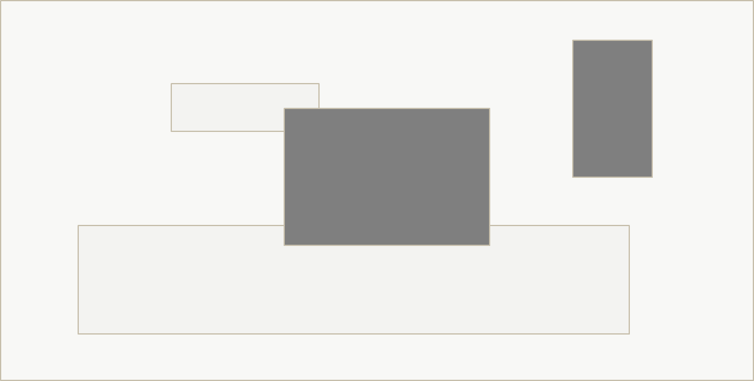
Interval Trees
Rectangle Intersection

Slide 31
Sweep Line Rectangle Intersection
Given N rectangles, find all that intersect each other

Slide 32
Sweep Line Rectangle Intersection
Save all rectangles left & right endpoint in sorted order

Slide 33
Sweep Line Rectangle Intersection
left endpoint: interval search + insert interval

Slide 34
Sweep Line Rectangle Intersection
left endpoint: interval search + insert interval

Slide 35
Sweep Line Rectangle Intersection
left endpoint: interval search + insert interval
Search hit

Slide 36
Sweep Line Rectangle Intersection
right endpoint: remove interval

Slide 37
Sweep Line Rectangle Intersection
right endpoint: remove interval

Slide 38
Sweep Line Rectangle Intersection
left endpoint: interval search + insert interval

Slide 39
Sweep Line Rectangle Intersection
right endpoint: remove interval

Slide 40
Sweep Line Rectangle Intersection
right endpoint: remove interval

Slide 41
Quad Trees
Object Intersection Search

Slide 42
Quad Trees
Quad-Trees are 2D space partitioning trees
Recursively divide space into quads (quadrants)
Each node has 0 or 4 children
Offer efficient bounds check for collision detection

Slide 43
QuadTree: Insertion
Find deepest node to insert element
void Insert(element)
node = root;
while (node.Children != null)
quadrant = Get-Quadrant(node, element)
if (quadrant == -1) break;
node = node.Children[quadrant]
node.Elements.Add(element)
Try-Split(node)
Split node into 4 children if max element capacity is reached

Slide 44
Node Splitting – Max = 4
void Insert(element)
node = root;
while (node.Children != null)
quadrant = Get-Quadrant(node, element)
if (quadrant == -1) break;
node = node.Children[quadrant]
node.Elements.Add(element)
Try-Split(node)
Split node into 4 children if max element capacity is reached

Slide 45
Quad Trees Insertion
Insert

Slide 46
Quad Trees Insertion
Insert

Slide 47
Quad Trees Insertion
Insert

Slide 48
Quad Trees Insertion
Insert
Node has 4 elements → split

Slide 49
Quad Trees Insertion
Create 4 child nodes

Slide 50
Quad Trees Insertion
Move into 0th quadrant

Slide 51
Quad Trees Insertion
Move into 1st quadrant

Slide 52
Quad Trees Insertion
Move into 3rd quadrant
Cannot move

Slide 53
Quad Trees Insertion
Insert
Try to insert it at the deepest level
Fits into 3rd quadrant

Slide 54
Quad Trees Insertion
Move into 3rd quadrant

Slide 55
Quad Trees Insertion
Insert
Try to insert it at the deepest level
Fits into 3rd quadrant

Slide 56
Quad Trees Insertion
Move into 3rd quadrant

Slide 57
Quad Trees Insertion
Insert
Try to insert it at the deepest level
Fits into 3rd quadrant

Slide 58
Quad Trees Insertion
Move into 3rd quadrant
Node elements == 4 → Split

Slide 59
Quad Trees Insertion
Subdivide 3rd quadrant into 4

Slide 60
Quad Trees Insertion
Move

Slide 61
Quad Trees Insertion
Move

Slide 62
Quad Trees Insertion
Move

Slide 63
Quad Trees Insertion
Insert

Slide 64
Quad Trees Insertion
Insert

Slide 65
Quad Trees Search
Search potential collisions with
fits into a q → add elements and go to q
does not fit → add all from node + children

Slide 66
Quad Trees Search
fits into 3rd → go to 3rd
Result:

Slide 67
Quad Trees Search
doesn't fit anywhere → add all in node + children
Result:

Slide 68
Quad Trees Search
doesn't fit anywhere → add all in node + children
Result:

Slide 69
Quad Trees Search
doesn't fit anywhere → add all in node + children
Result:

Slide 70
Quad Trees Search
doesn't fit anywhere → add all in node + children
Result:

Slide 71
Quad Trees Search
doesn't fit anywhere → add all in node + children
Result:
Over

Slide 72
Trees - Quiz
TIME’S UP!
TIME:
Show results from search for in quad tree

Slide 73
Trees - Quiz
TIME’S UP!
Elements:

Slide 74
Endless Splitting
Insert four points

Slide 75
Endless Splitting
Split node

Slide 76
Endless Splitting
Split node

Slide 77
Endless Splitting
Solution: define max depth
Also leads to clustering

Slide 78
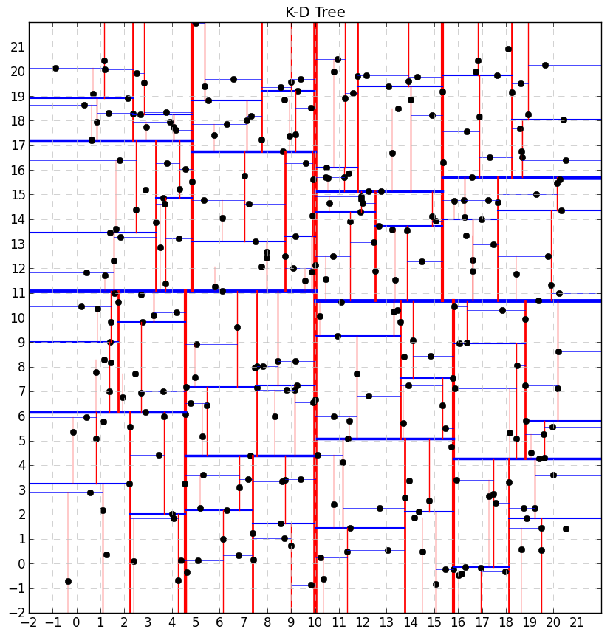
K-D Trees
Splitting Dimensions

Slide 79
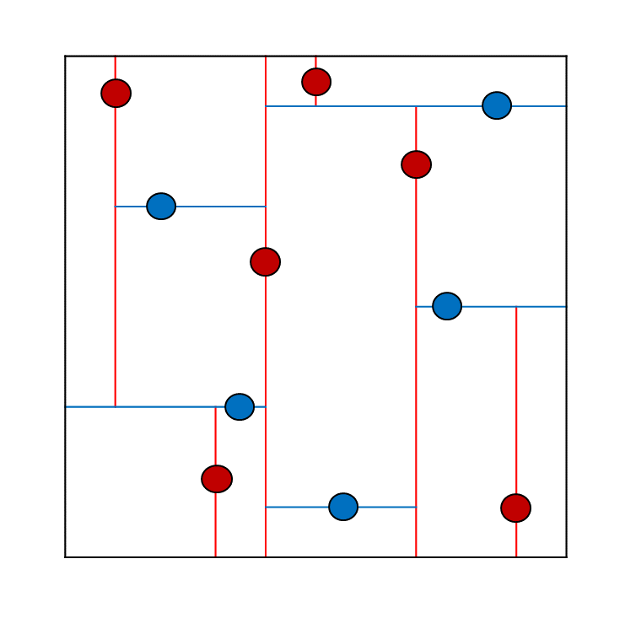
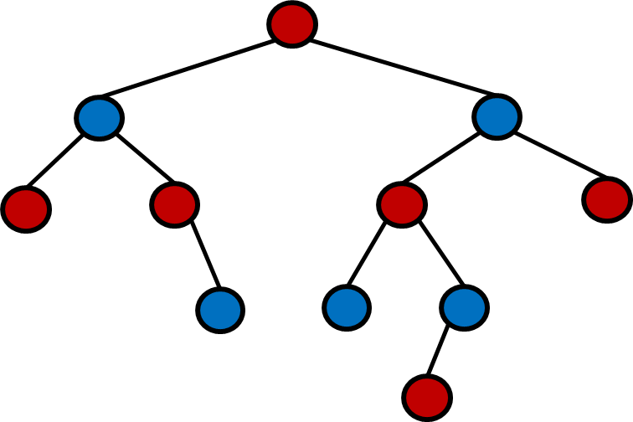
2-d Tree
2-d tree is a space-partitioning data structure
Still a BST (every node has 2 children)
Еvery node splits its own plane in two parts
How to store 2 dimensional data?

Slide 80
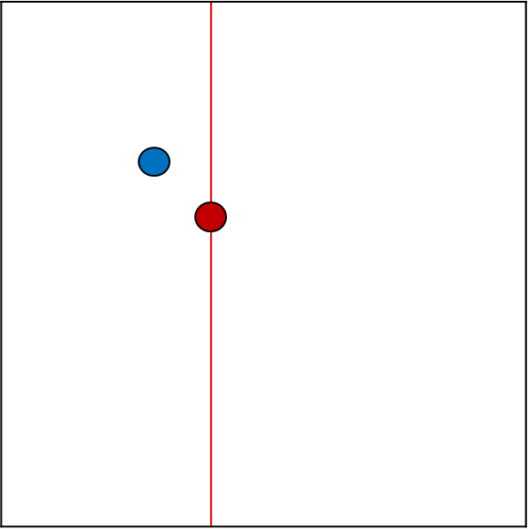
2-d Tree
On insertion →
Determine left or right
if depth % 2 == 0 → compare points by X
if depth % 2 == 1 → compare points by Y
Root at (4, 6)
Insert Point at (3, 7)
(3, 7)
7
6
(4, 6)
3
4
0
1

Slide 81
2-d Tree Insert
depth % 2 == 0 → split by X
0
1
2
3
0,0
4

Slide 82
2-d Tree Insert
compare by X → go left
depth % 2 == 1 → split by Y
0
1
2
3
0,0
4

Slide 83
2-d Tree Insert
compare by X → go left
depth % 2 == 1 → split by Y
0
1
2
3
0,0
4

Slide 84
2-d Tree Insert
compare by X → go left
0
1
2
3
0,0
4

Slide 85
2-d Tree Insert
compare by Y → go right
0
1
2
3
0,0
4

Slide 86
2-d Tree Insert
depth % 2 == 0 → split by X
0
1
2
3
0,0
4

Slide 87
2-d Tree Insert
compare by X → go left
0
1
2
3
0,0
4

Slide 88
2-d Tree Insert
compare by Y → go right
0
1
2
3
0,0
4

Slide 89
2-d Tree Insert
compare by X → go right
0
1
2
3
0,0
4

Slide 90
2-d Tree Insert
compare by X → go right
0
1
2
3
0,0
4

Slide 91
2-d Tree Insert
depth % 2 == 1 → split by Y
0
1
2
3
0,0
4

Slide 92
2-d Tree Insert
depth == 0 → compare by X
→ go right
0
1
2
3
0,0
4

Slide 93
2-d Tree Insert
depth % 2 == 1 → split by Y
0
1
2
3
0,0
4

Slide 94
2-d Tree Insert
depth % 2 == 1 → split by Y
0
1
2
3
0,0
4

Slide 95
2-d Tree Insert
0
1
2
3
0,0
4

Slide 96
2-d Tree Insert
0
1
2
3
0,0
4

Slide 97
2-d Tree Insert
0
1
2
3
0,0
4

Slide 98
2-d Tree Insert
0
1
2
3
0,0
4

Slide 99
2-d Tree Insert
0
1
2
3
4

Slide 100
2-d Tree Insert
0
1
2
3
0,0
4

Slide 101
2-d Tree Insert
0
1
2
3
0,0
4

Slide 102
2-d Tree Insert
0
1
2
3
0,0
4

Slide 103
2-d Tree Insert
0
1
2
3
0,0
4

Slide 104
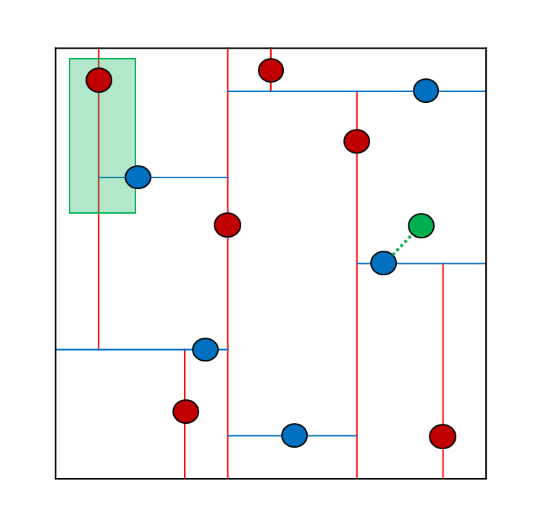
Range Search
Point in a Given Rectangle

Slide 105
Range Search
Each node has a Rectangle
Root → whole Plane

Slide 106
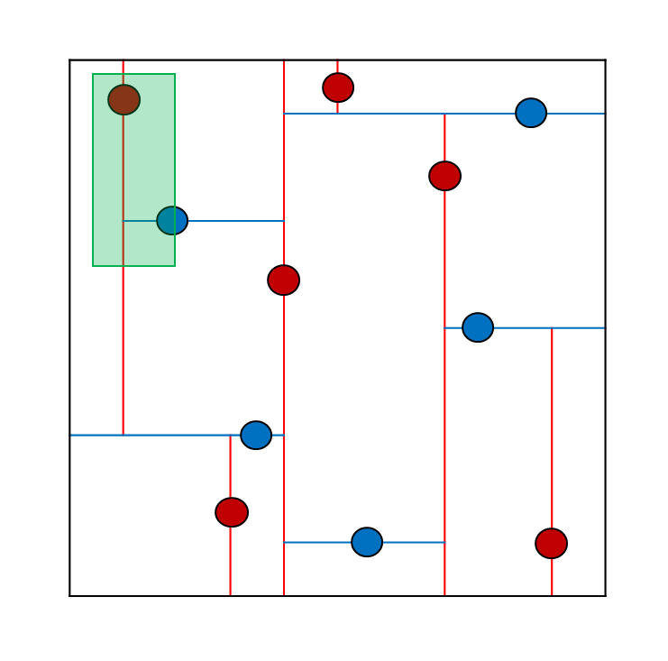
Range Search Algorithm
Recursively
Check if point is in rectangle
Search left (if left node rectangle intersects given)
Search right (if right node rectangle intersects given)

Slide 107
Range Search
Get all within the rectangle
0
1
2
3
4

Slide 108
Range Search
Check root → not in range
0
1
2
3
4

Slide 109
Range Search
left intersects → go left
0
1
2
3
4

Slide 110
Range Search
check root → not in range
0
1
2
3
4

Slide 111
Range Search
! left intersects → skip
0
1
2
3
4

Slide 112
Range Search
right intersects → go right
0
1
2
3
4

Slide 113
Range Search
check root → intersects
0
1
2
3
4

Slide 114
Range Search
left is null → skip
0
1
2
3
4

Slide 115
Range Search
right intersects → go right
0
1
2
3
4

Slide 116
Range Search
check root → intersects
0
1
2
3
4

Slide 117
Range Search
left is null → skip
0
1
2
3
4

Slide 118
Range Search
right is null → skip
0
1
2
3
4

Slide 119
Range Search
done → return
0
1
2
3
4

Slide 120
Range Search
done → return
0
1
2
3
4

Slide 121
Range Search
done → return
0
1
2
3
4

Slide 122
Range Search
right !intersects range → skip
0
1
2
3
4

Slide 123
Range Search
done → return
over
0
1
2
3
4

Slide 124
K-d Tree Search
Efficient search for:
Range search
Nearest neighbour
(4, 6)

Slide 125
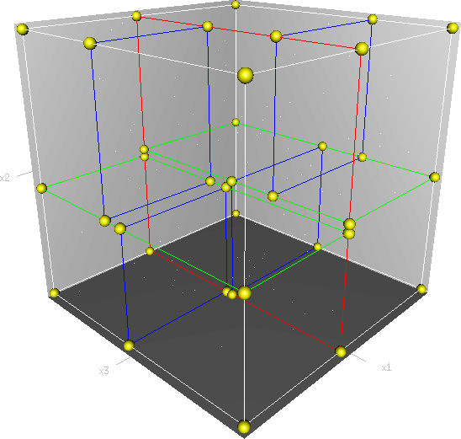
K-d Tree
Create a K-d tree by increasing k
compare by depth % k
Example – 3-d Tree →

Slide 126
Lab Exercise
K-d Trees

Slide 127

Summary
Interval trees provide efficient search for overlapping intervals
Can be used for rectangle intersection search
Quad trees provide efficient search for intersecting objects
K-d trees provide fast retrieval of multidimensional data

Slide 128
License
This course (slides, examples, labs, videos, homework, etc.) is licensed under the "Creative Commons Attribution-NonCommercial-ShareAlike 4.0 International" license
Attribution: this work may contain portions from
"Fundamentals of Computer Programming with C#" book by Svetlin Nakov & Co. under CC-BY-SA license
"Data Structures and Algorithms" course by Telerik Academy under CC-BY-NC-SA license

Slide 129





Free Trainings @ Software University
Software University Foundation – softuni.org
Software University – High-Quality Education, Profession and Job for Software Developers
softuni.bg
Software University @ Facebook
facebook.com/SoftwareUniversity
Software University @ YouTube
youtube.com/SoftwareUniversity
Software University Forums – forum.softuni.bg

